Slide 1
SECURE DATA HIDING IN IMAGES USING STEGANOGRAPHY
SECURE THE DATA TO PREVENT HACKERS
Presented By:
Chikkam Pavan Kalyan
ADIKAVI NANNAYA UNIVERSITY
Department of computer Science and Engineering

Slide 2
OUTLINE
Problem Statement
Technology used
Wow factor
End users
Result
Conclusion
Git-hub Link
Future scope

Slide 3
Problem Statement
Traditional message-sharing methods are prone to interception, risking unauthorized access to sensitive information.
Encryption alone often signals that a hidden message exists, attracting unwanted attention.
Steganography conceals the very presence of communication, enhancing security.
Our project aims to embed secret messages within images without noticeably altering the image.

Slide 4
Technology used
Programming Language: Python 3
Libraries:
OpenCV (for image processing)
os (for file operations)
Platform/Environment:
Python IDLE / VS Code / Jupyter Notebook (choose your preferred)
GitHub for version control and repository management

Slide 5
Wow factors
Seamless Embedding: Utilizes lossless image formats (PNG) to preserve exact pixel data.
Dual Scripts (Encryption & Decryption): Clear separation of concerns for easy maintenance and scalability.
Passcode Protection: Ensures only authorized users can reveal the hidden message.
Metadata File: Stores message length and passcode for accurate retrieval without complex data structures.

Slide 6
End users
Individuals & Researchers needing a secure way to hide personal or confidential information.
Organizations looking to conceal sensitive data without drawing attention.
Educational Institutes teaching the principles of cryptography and steganography.

Slide 7
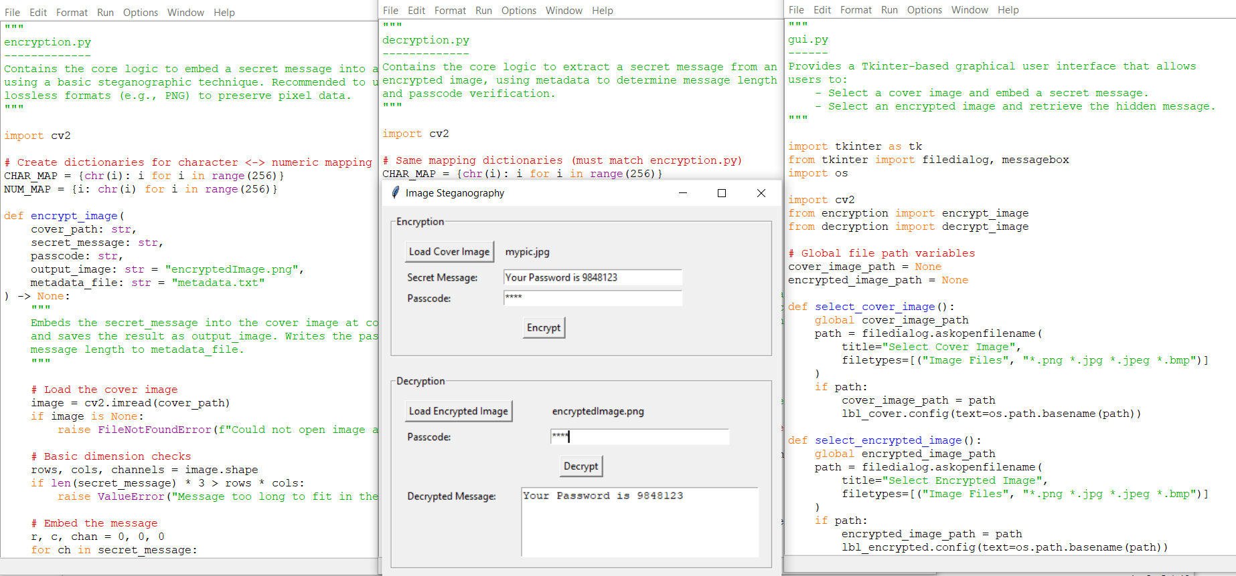


Results
ENCRYPTED
DECRYPTED
GUI
INPUT
OUTPUT
Decrypted Message

Slide 8
Conclusion
The project successfully addresses the problem of covert communication by embedding messages in images without noticeable alteration.
By leveraging lossless formats, the embedded data remains intact, allowing reliable decryption.
The passcode-based approach adds an additional layer of security, ensuring only authorized parties can reveal the hidden message.

Slide 9
GitHub Link
Repository URL:
https://github.com/pavankalyanchikkam/Image-Steganography-Secret-Message-Encryption-and-Decryption.git
Contains two Python scripts:
encryption.py: Embeds the secret message in the image
decryption.py: Recovers the message if the correct passcode is provided
Also includes a README.md with setup instructions and project details.

Slide 10
Future scope(optional)
Advanced Encryption: Incorporate robust encryption algorithms before embedding to enhance security.
Multiple File Types: Extend support to other file formats (e.g., audio, video) for broader steganography applications.
Automated Key Management: Implement a secure key exchange mechanism to avoid manual passcode entry.
GUI Implementation: Develop a user-friendly graphical interface for non-technical users.

Slide 11
THANK YOU

